Slide 1

Towards hail detection from satellite images using ML
Capstone Project Presentation:
Jordi Figueras i Ventura
Supervisor: Mohamad Dia
Certificate of Open Studies (COS):
Applied Data Science: Machine learning

Slide 2
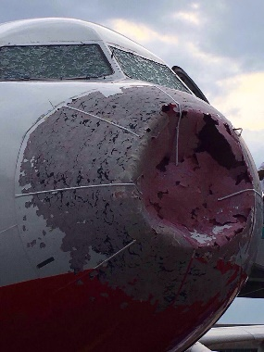
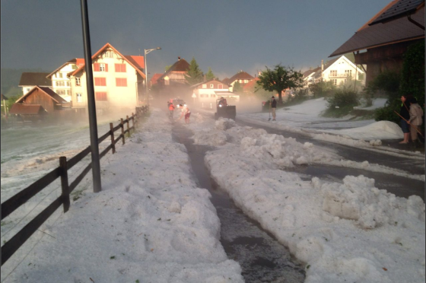
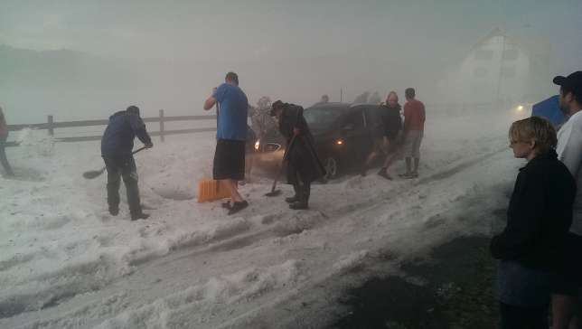
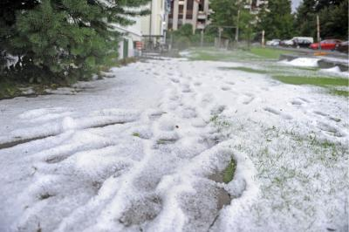

Motivation
Hail one of the most costly natural hazards:
1.5 billion CHF paid by insurers for agriculture damage in Switzerland between 1972 and 2012
Significant hazard for aviation
Very localized phenomenon, very difficult to predict

Slide 3
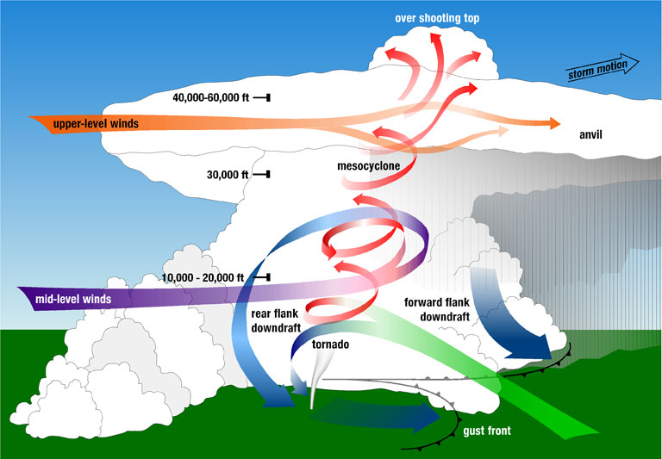
Severe storm structure

Slide 4
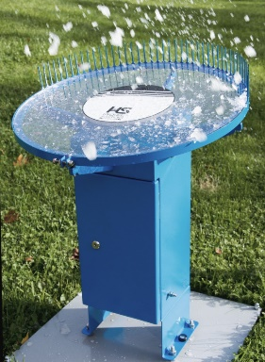
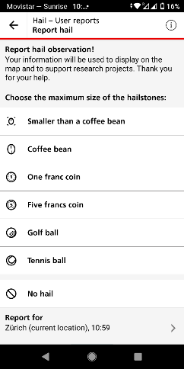
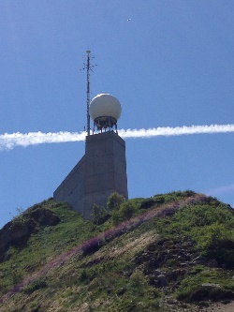
Hail detection
Hail pads, hail sensors:
Precise information on hailstone size and timing ✓
Very sparse coverage ✗
Crowdsourcing:
Good coverage (mostly in urban areas and by day) ✓
Timing, location and hailstone size with uncertainties ✗
Radar:
Good coverage over extensive area with precise timing ✓
Uncertainties in hail detection and hailstone size estimation ✗

Slide 5
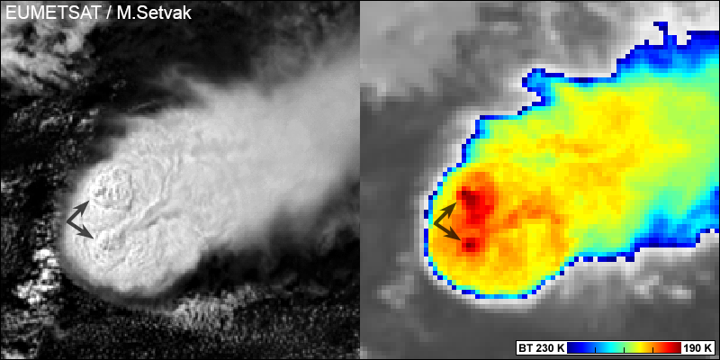
Hail detection by satellite
24/7 global coverage including non-instrumented areas
Detection performed indirectly through observation of characteristic cloud structures, e.g. overshooting tops
Currently detection performed manually by trained forecasters

Slide 6
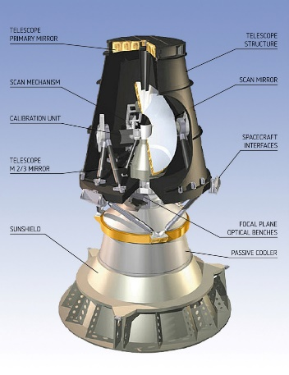
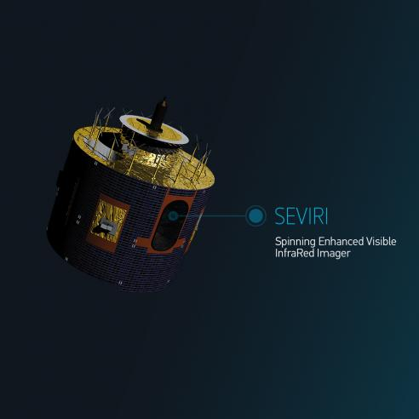
METEOSAT SEVIRI
12 spectral channels (4 visible-8 infrared) sensitive to different physical phenomena
Further information from channel differences
3 km resolution (1 km HRV)
5 min temporal resolution (Fast scanning mode)

Slide 7
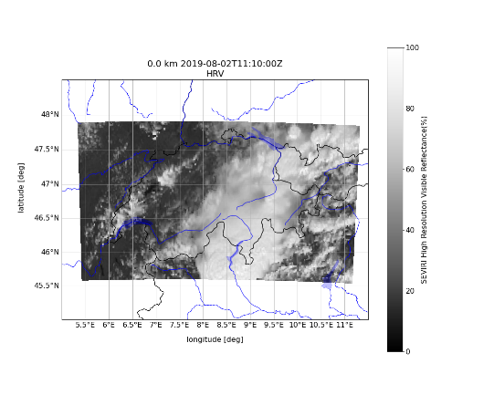
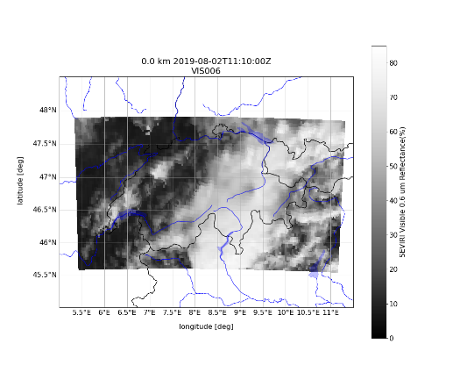
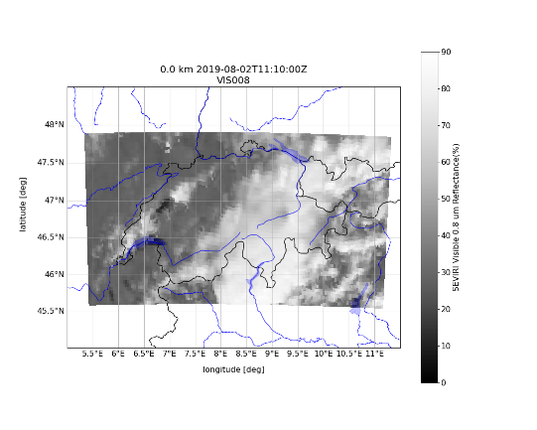
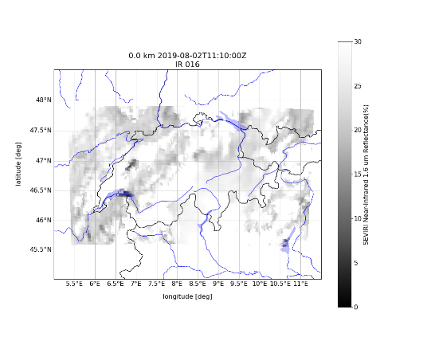
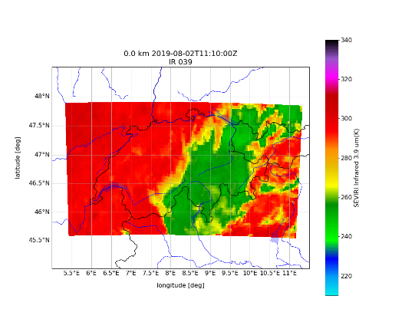
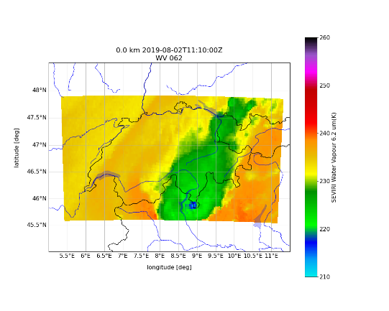
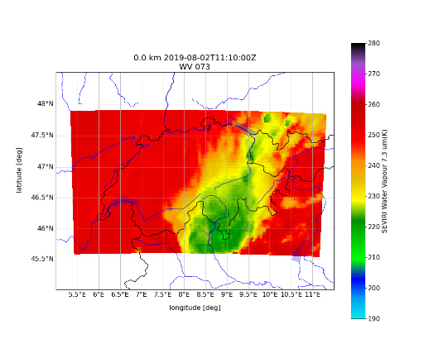
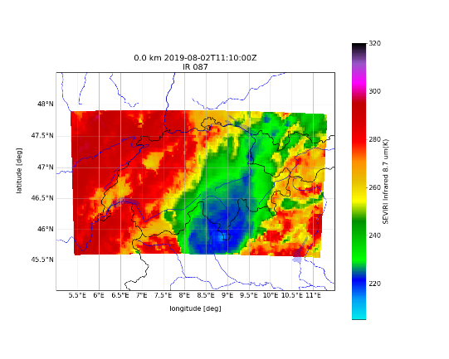
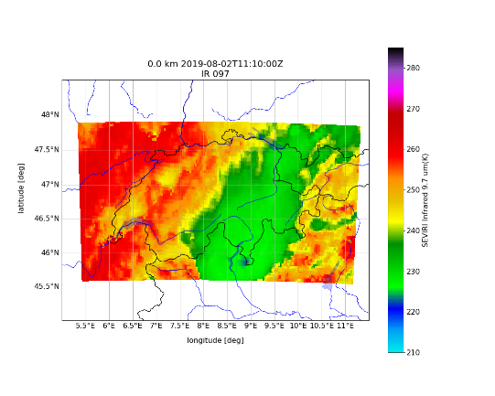
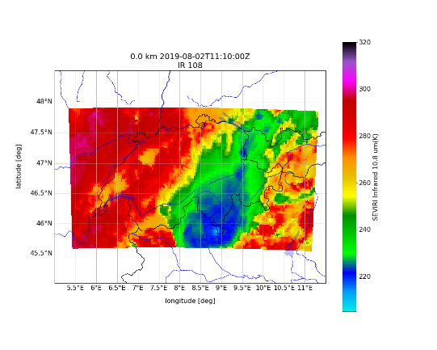

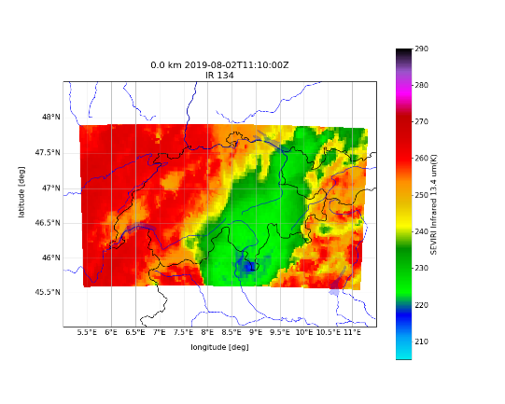

Slide 8
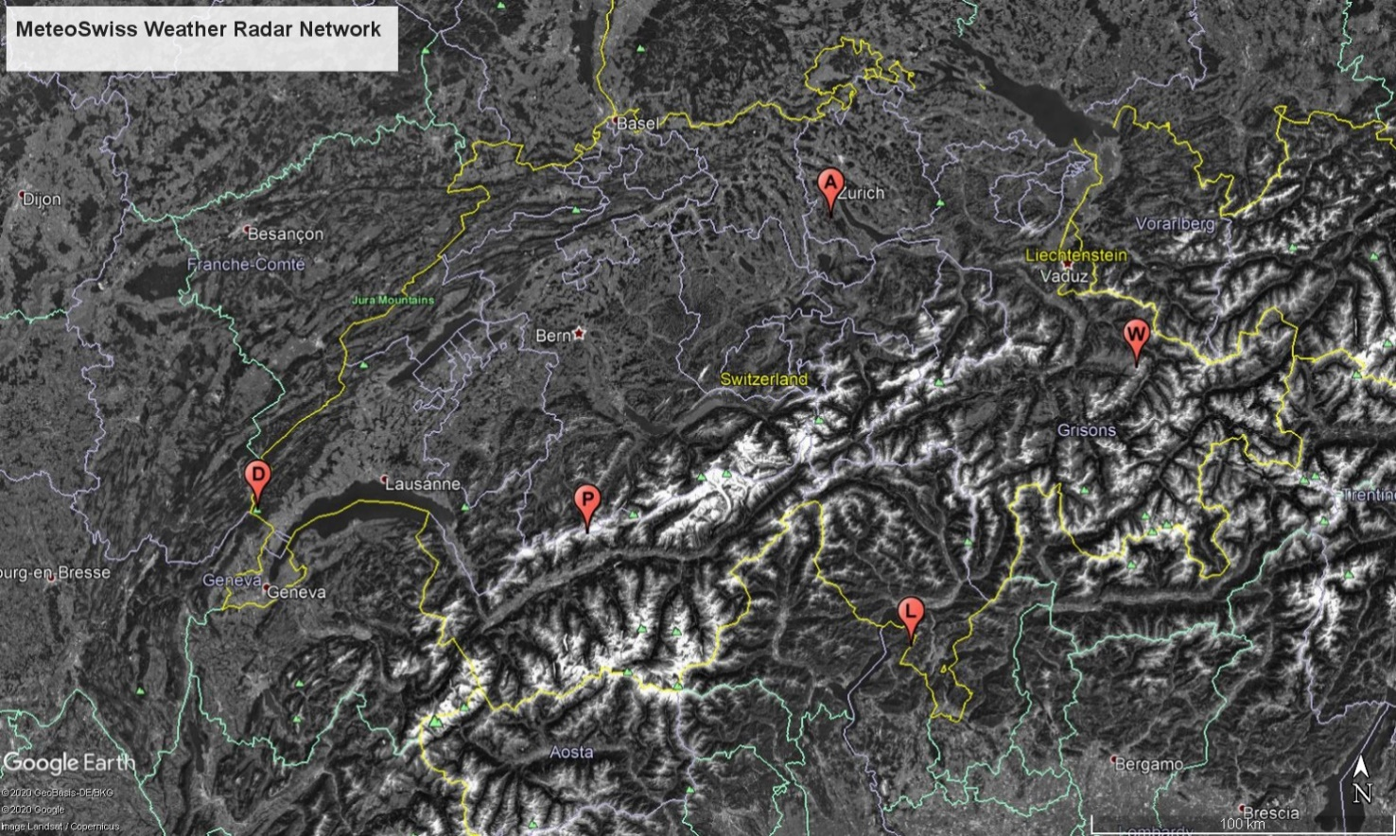
Hail detection with radar: POH algorithm
Echotop 45 dBZ: Maximum altitude at which the radar reflectivity is 45 dBZ or higher

Slide 9
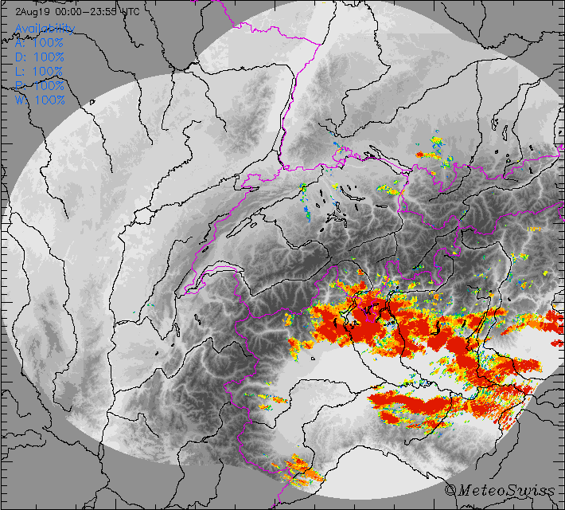
Hail detection with radar
POH ≥ 90%: Hail on the ground very likely
This is our target!

Slide 10
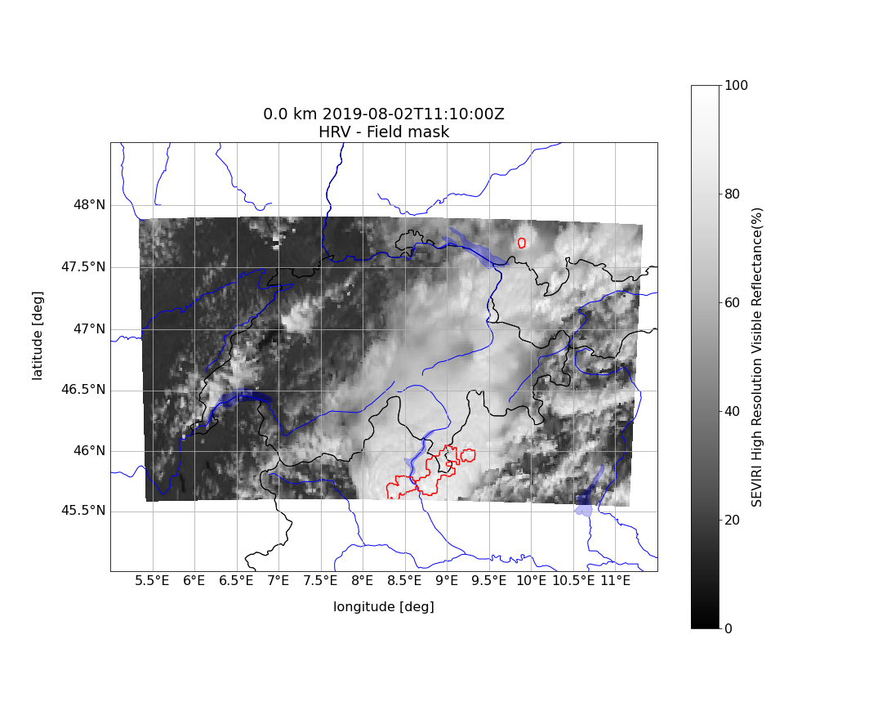

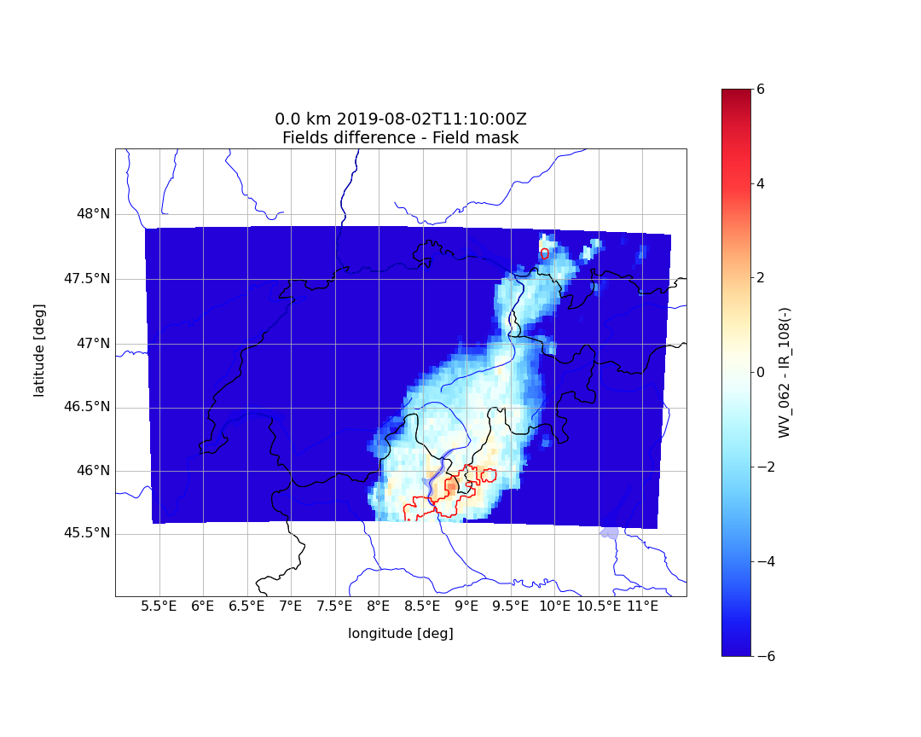
Relationship POH-Satellite images
Cloud top height
WV_062-IR_108
Used by humans to detect overshooting tops
We normalize by sun zenith angle
Cloud water content

Slide 11
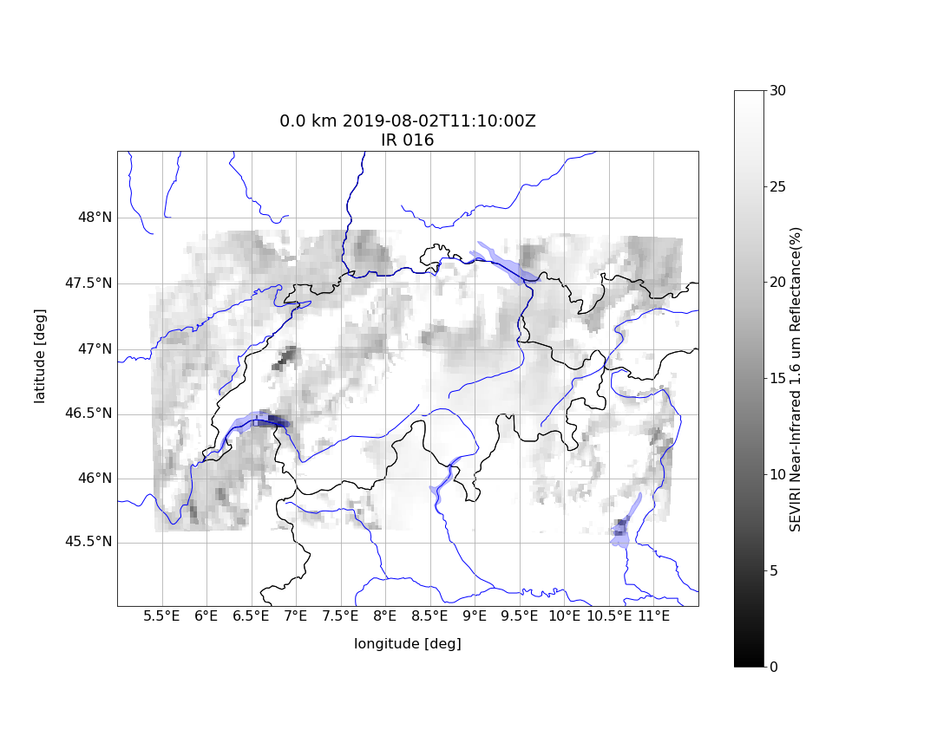
Feature added later on
Cloud top phase

Slide 12
Dataset
Convective season (April-September) of 2018, 2019, 2020 (Until July)
448x256 1km-resolution images
Daylight only, images containing at least 1 POH90 pixel
Missing images due to gaps in the satellite archive and corrupted data
4351 images available!

Slide 13
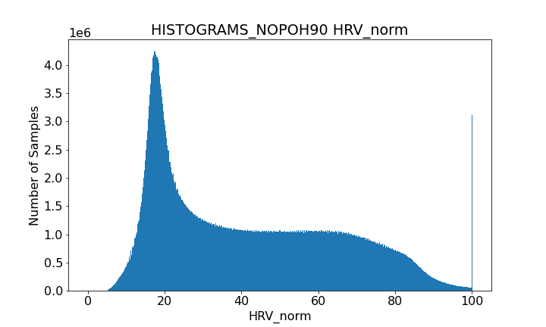
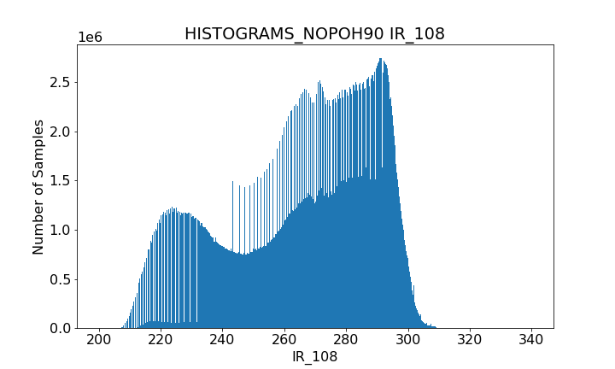
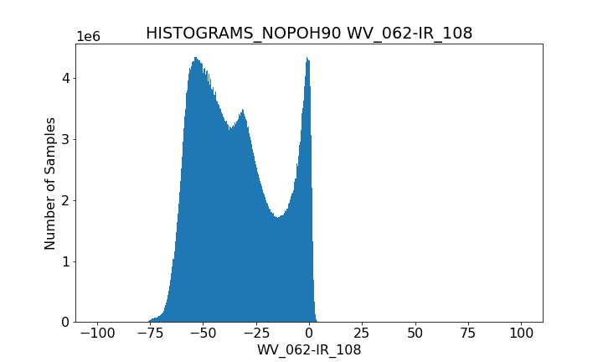
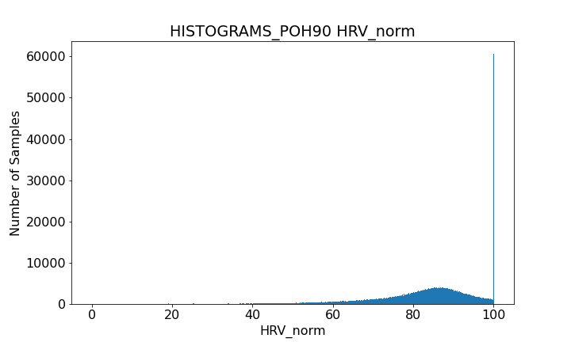
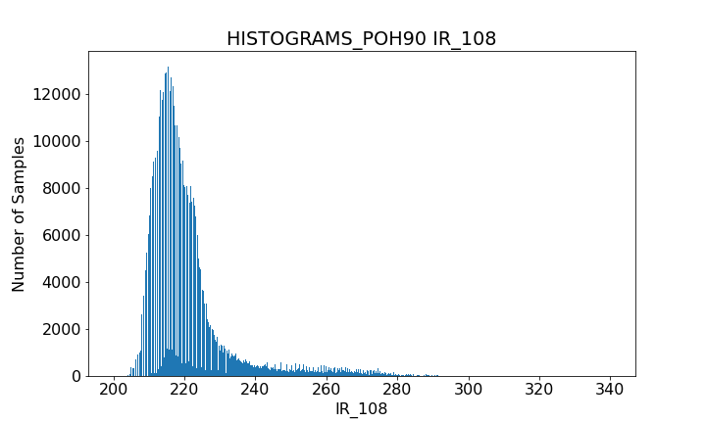
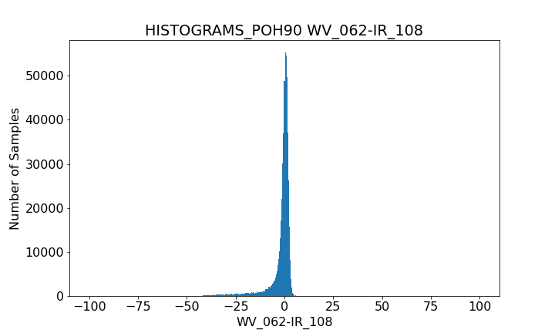
EDA

Slide 14
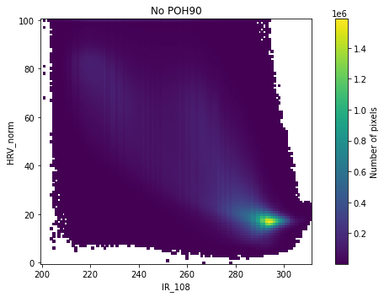
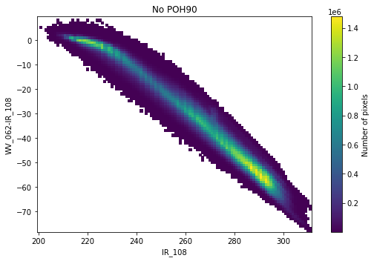
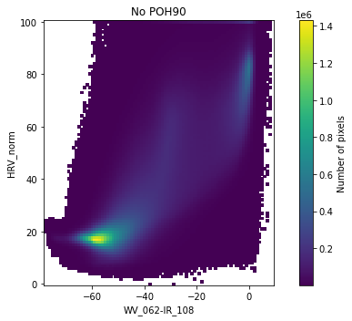
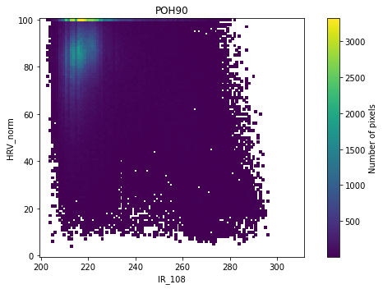
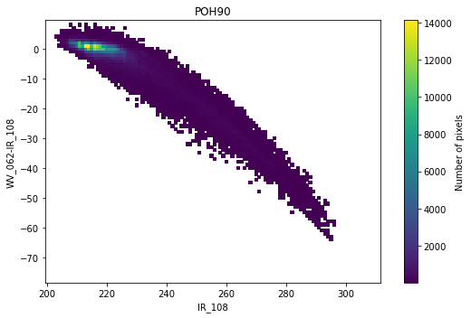
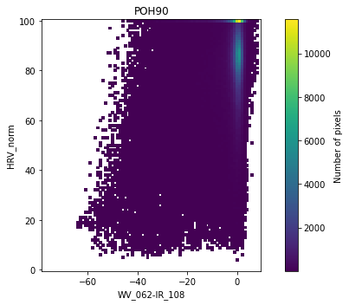
EDA

Slide 15
EDA conclusions
Extremely large imbalance: Hail pixels 0.1% of total
Distinct distributions of hail/no hail features BUT large overlap

Slide 16
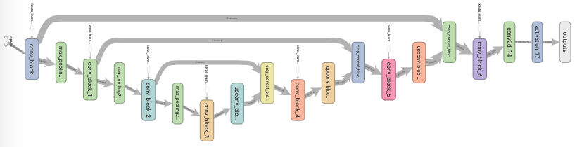
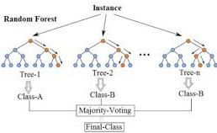
Proposed models
Random Forests family:
Deals with non-linear data
Scalable
Pixel-based
Contribution of each feature easily measurable
U-net architecture:
CNN for semantic image segmentation=> learns spatial structure
Large amount of data needed for training

Slide 17
Pre-processing
Random Forests family:
Thresholds to keep only areas of interest:
IR_108 < 240 k
Window > -50 K
7-km texture of each variable to get information of spatial structure
Remove pixels with NaN values in the texture
U-net architecture:
Min-max scaling
One-hot encoding of the target

Slide 18
Random Forest models
7,432,290 pixels used (0.8% contain hail):
10% for test
10% of remaining for validation
Grid search with 5-fold random shuffle validation
Parameter to optimize: Number of trees from 1 to 50

Slide 19
RF models tested
Score optimized
[1] Classic RF
[2] Class weighted RF
We penalize more misclassification of the less frequent class (frequency computed over whole dataset)
[3] Bootstrap class weighted RF:
As previous but frequency computed over each bootstrap sample
[4] Balanced RF:
We perform random under-sampling of the majority class in each bootstrap sample to equilibrate the class frequency
[5] Easy Ensemble for imbalanced classification:
We create multiple datasets consisting of all samples of the minority class and a random selection of the majority class
Accuracy [1]:
(TP + TN)/(TP + TN + FP + FN)
Balanced accuracy [1, 2, 3, 4, 5]:
The average of the recall of each class:
1/2[TP/(TP+FN)+TN/(TN+FP)]
Precision [4]:
TP/(TP+FP)
F-score [4]:
Harmonic mean of precision and recall
TP/[TP+0.5(FP+FN)]

Slide 20
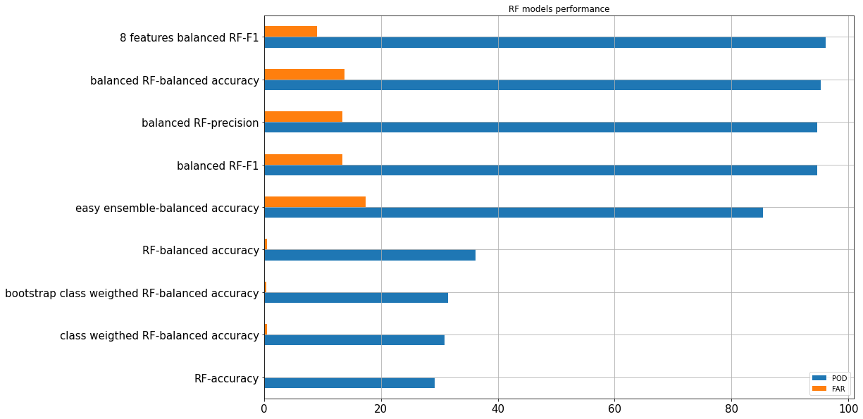
Results

Slide 21
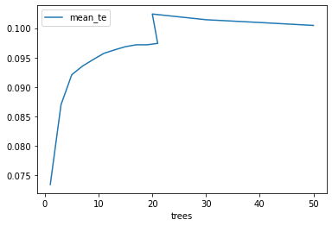
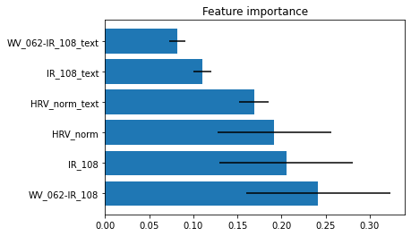
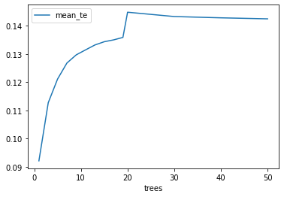
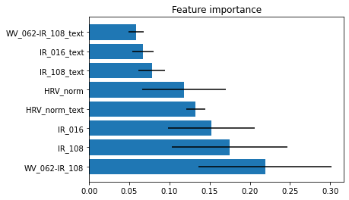
Balanced RF with F-score optimization
6 features
8 features

Slide 22
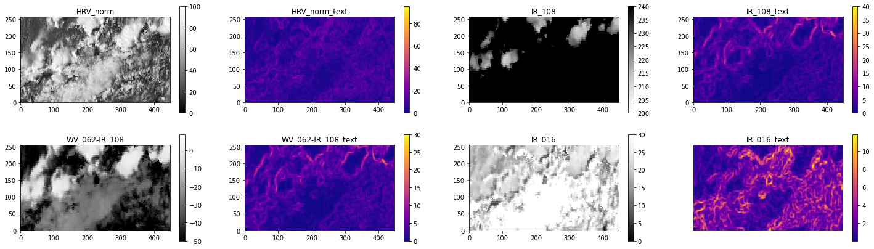
Results on individual image
2018-06-08 13:45 UTC

Slide 23
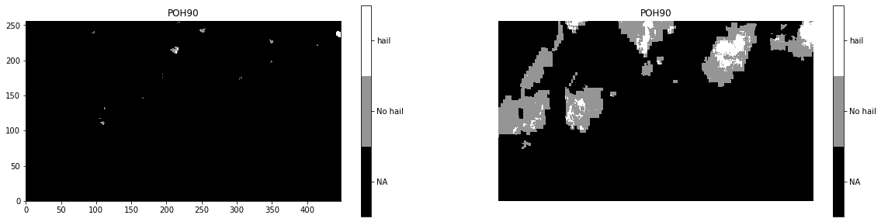
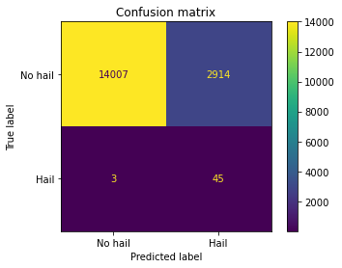
Results on individual image
POD: 93.75%
FAR: 17.22%

Slide 24
U-NET model
4351 images used (0.1% of pixels contain hail):
351 Test
400 Validation
Loss function: Weighted binary cross-entropy
Weights inversely proportional to class frequency (0.5 no hail/456 hail)

Slide 25
U-NET architectures tested
3 layers, 16 filters in first layer (patience 3 epochs and 6 epochs)
3 layers, 64 filters in first layer (patience 3 epochs)
3 layers, 64 filters with user defined weights (1/10) in the binary cross-entropy
5 layers => Problems with image size
3 layers, 64 filters, 4 channels

Slide 26
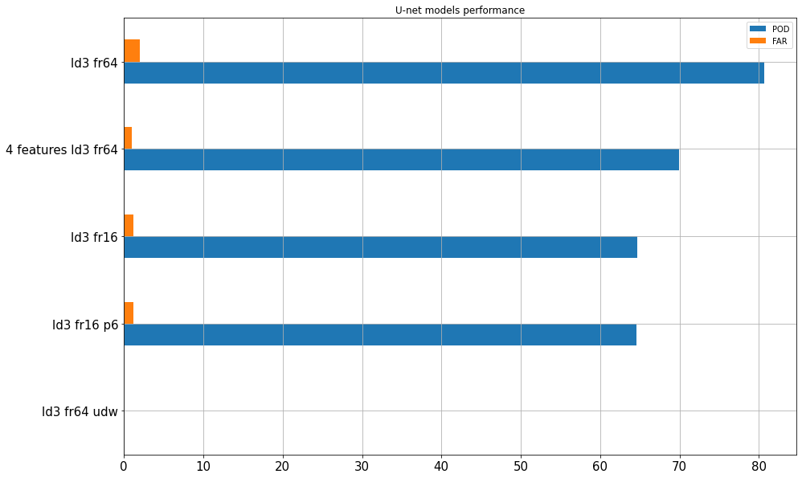
Results

Slide 27


Training results
3 channels
4 channels

Slide 28

Results on individual images

Slide 29
Conclusion
Large imbalance between classes and overlap of class distributions major challenges
Best classical model investigated : Balanced Random Forest with 8 features
Best u-net model investigated: 3 layers, 64 filters at first layer, 3 channels
Likely overfitting of u-net model
Balanced RF better performance than u-net
Long training times for u-net: consider use of GPUs

Slide 30
Future work
Increase the number of features:
All channels
Combination of channels
Metadata (solar time, day of the year, satellite viewing angle, etc.)
Investigate the sensitivity to POH threshold
Train a night time model
Use/train the model(s) over a wider area: All Europe? All Rapid Scan Service area? All METEOSAT viewing field?

Slide 31

Thank you!
Grazie!
Danke schön!
Merci!
Moltes gràcies!

